Slide 1
Inference on Future Business Attention and Trend: Text Mining on Yelp’s Review Text
Jiannan(Jeffrey) Zhang and
Yifang Peng
University of Texas at Austin

Slide 2

Outline
Presentation focused on main part (Text Mining) of this project (7 mins )
Q&A (1 min)

Slide 3
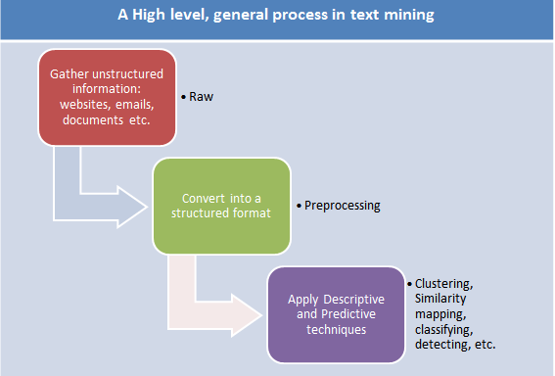
What is text mining?

Slide 4
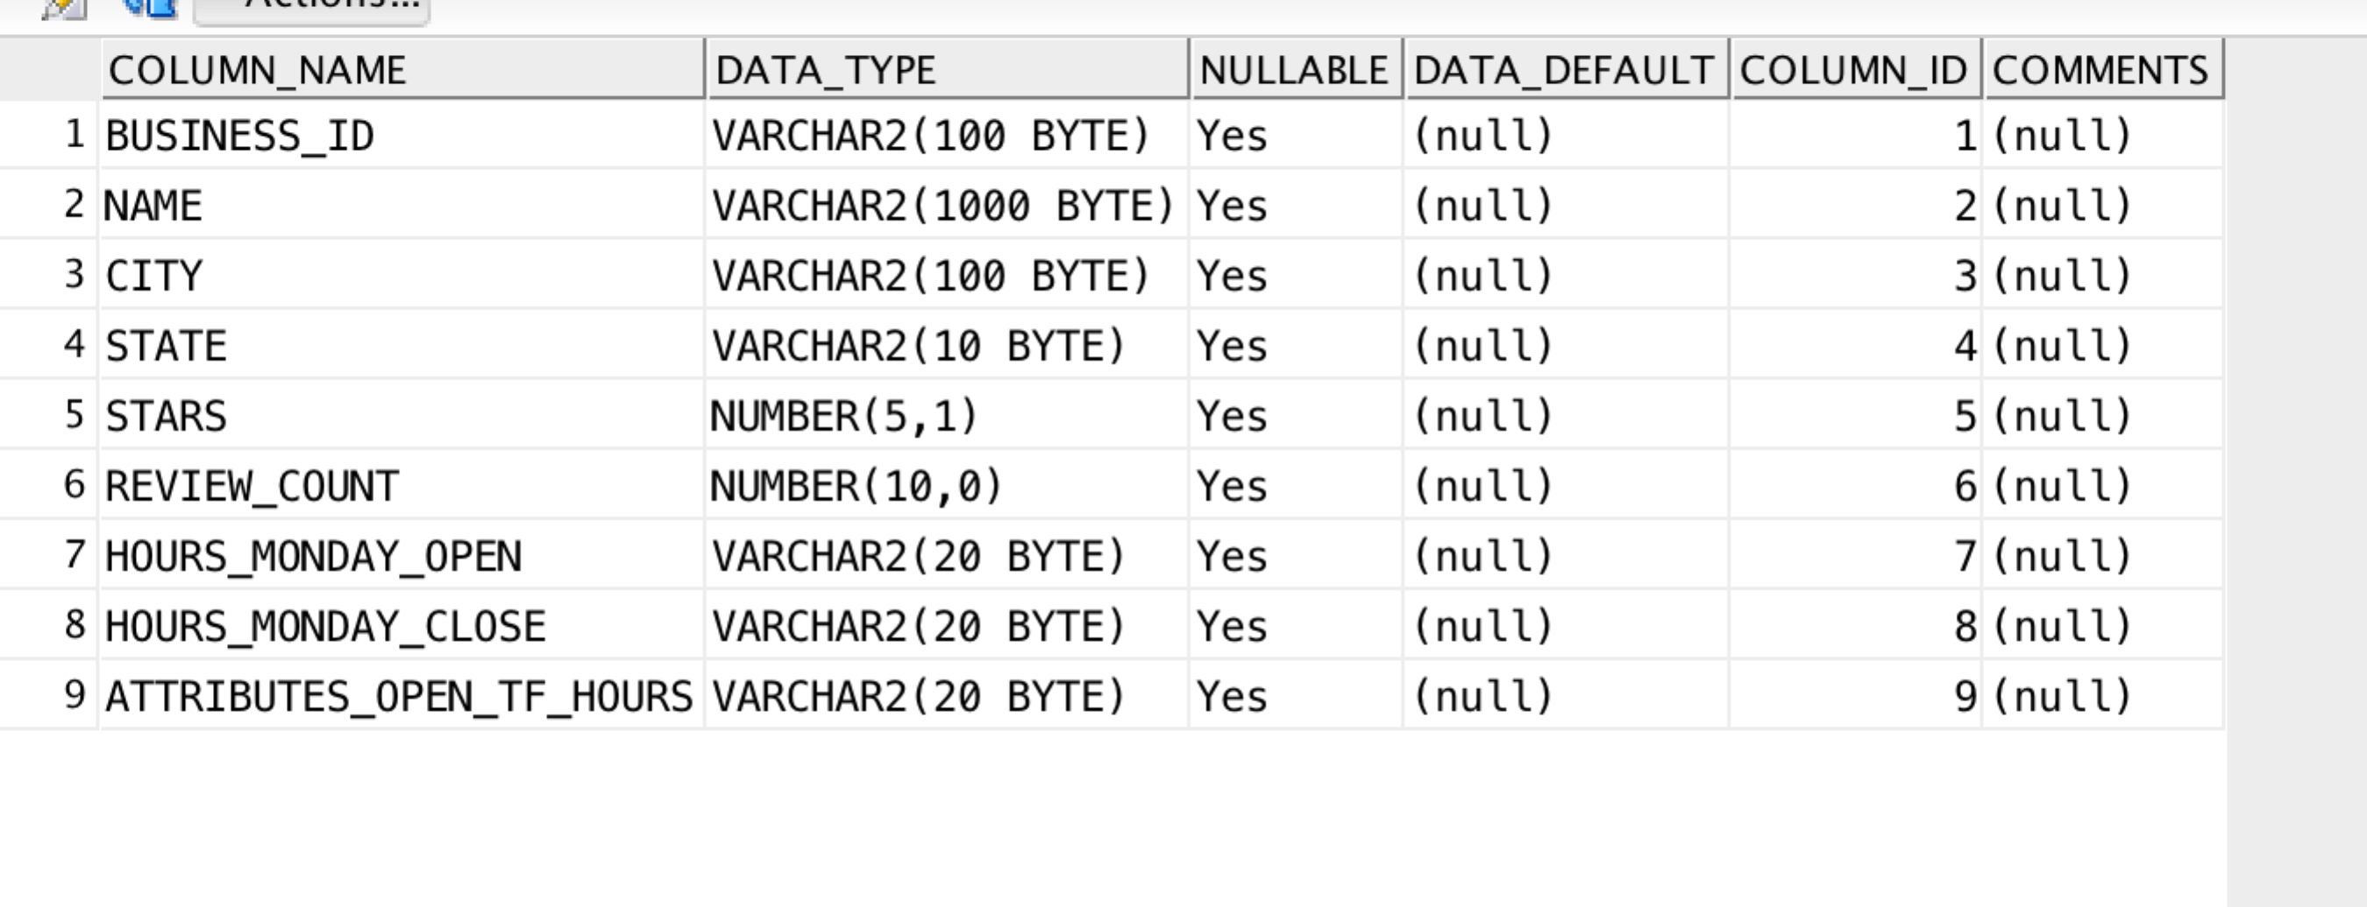
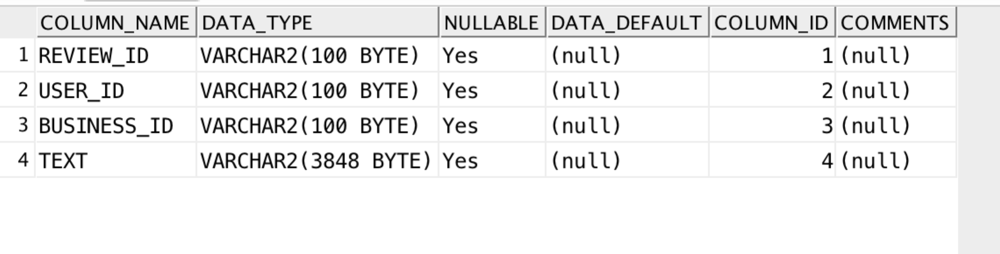
Raw Data
Business table
Review table

Slide 5
Preprocessing: Table transformations in SQL
Load the raw data into Oracle
Create new table for each state and its review text
Join BT and RT on B_id and select state, text column

Slide 6
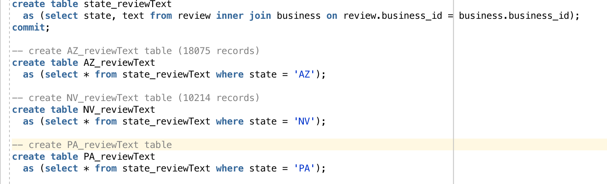
Sample queries on table transformation

Slide 7
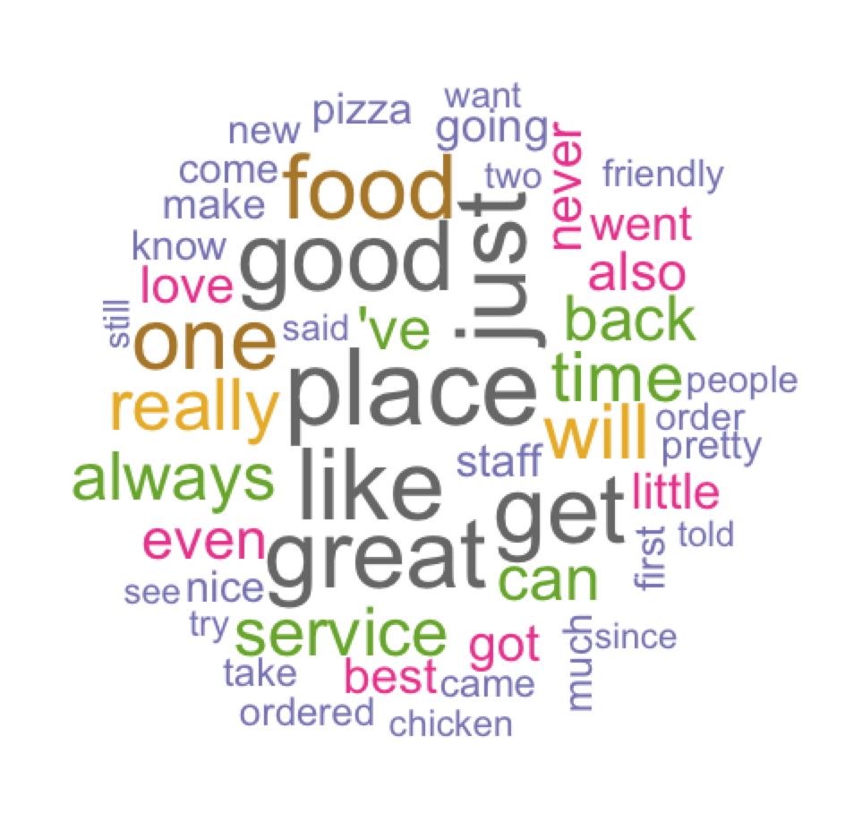
Main method 1: Word Cloud
Strip white space,
convert to lower, remove English common words like ‘the’ (so-called ‘stopwords’)
AZ (20K)

Slide 8
Main method 2: Hierarchical Clustering
Next Slide

Slide 9
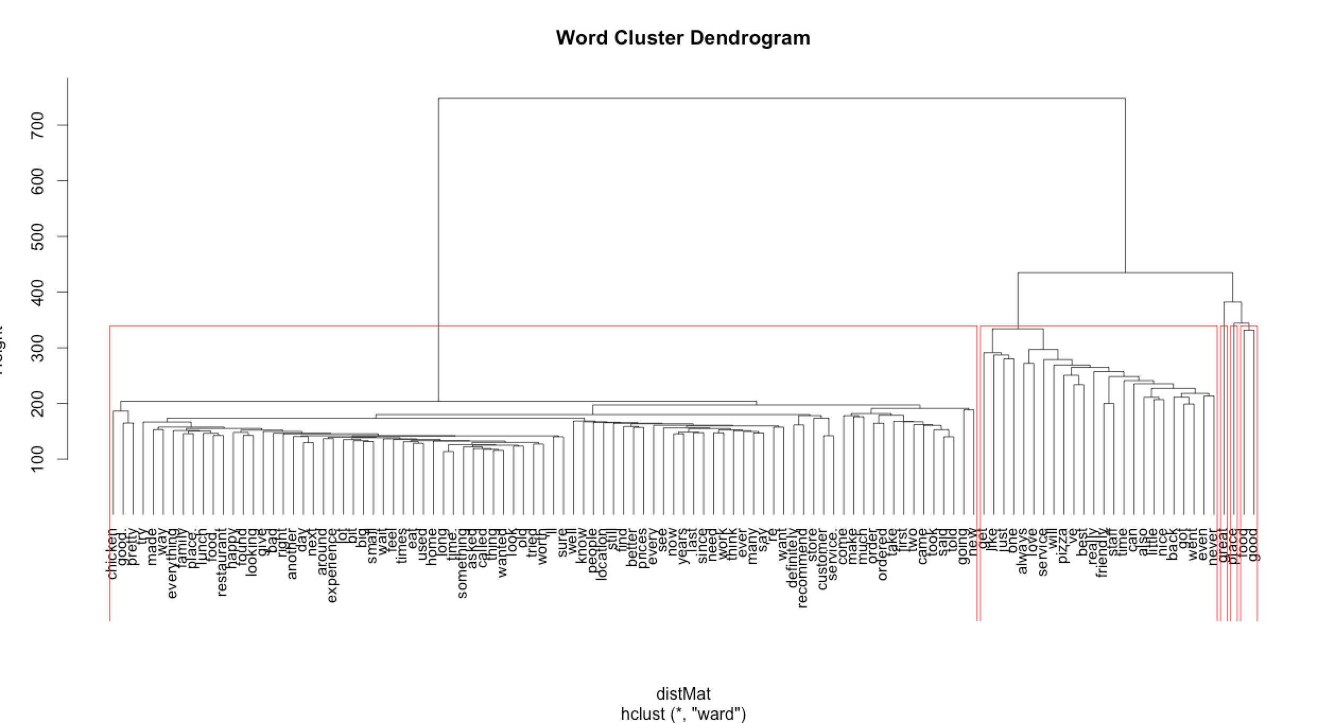
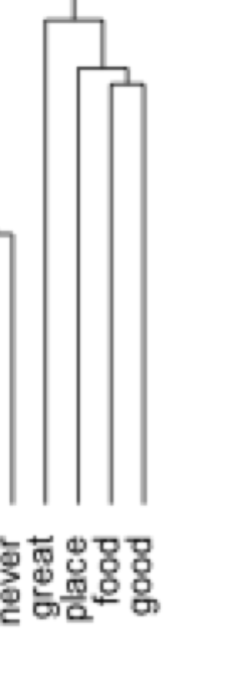

Slide 11
Discussion and Conclusion
We could infer that, overall or on AVG, pizza are more popular than chicken in AZ
Ovrall or on AVG, pizza-related businesses have better customer service than chicken-related business or restaurants
Pizza is everywhere in central Phoenix, with Cibo, Pizzeria Bianco, Pizza People Pub, Pomo Pizzeria…
- http://azbigmedia.com/

Slide 12
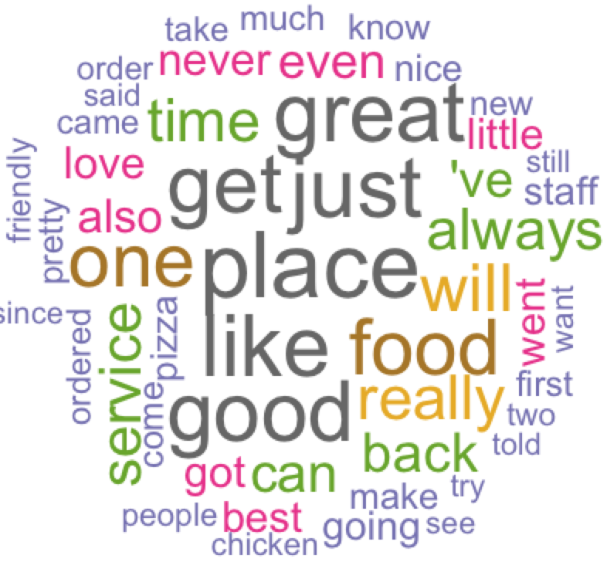
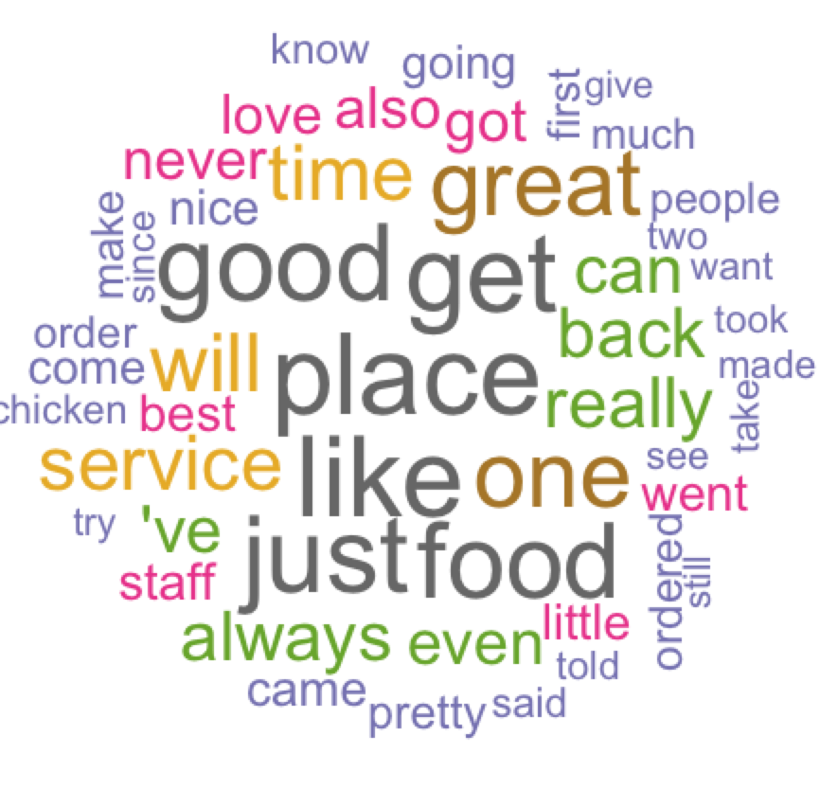
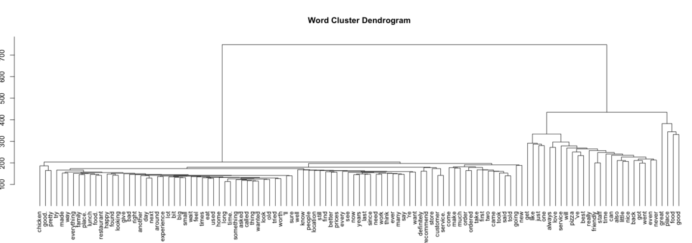

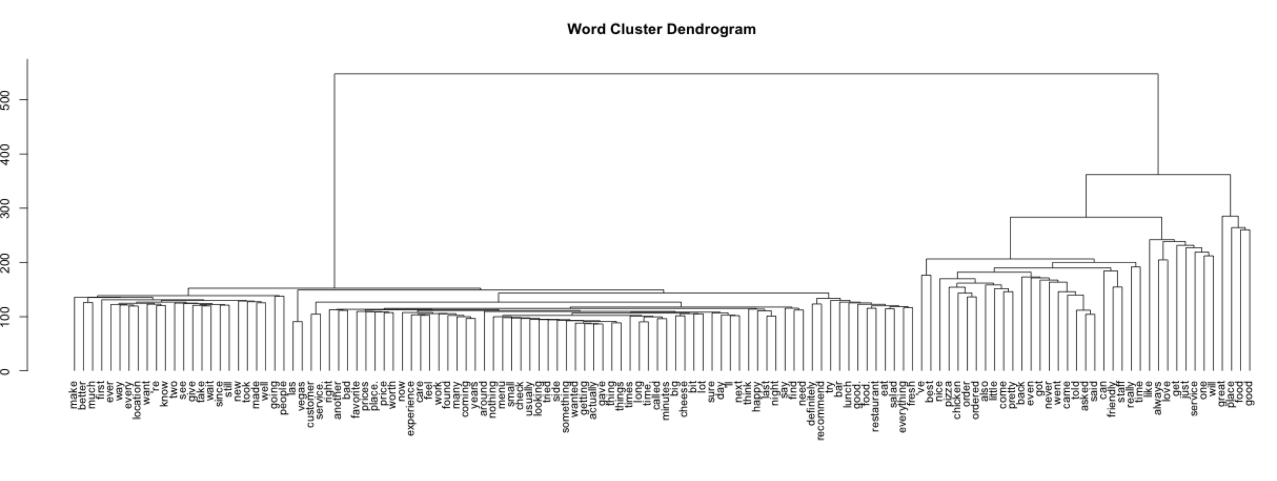
Compare

Slide 13
Discussion and Conclusion
We found that, compared with other states, the word frequency of words “best -> Pizza”, “good -> chicken” etc. are higher (same # of reviews)
There are going to be a big growth in the number of pizza and chicken restaurants in AZ in the future
Over the next 10 years, the fastest restaurant job growth is projected to occur in Arizona with a rate of 15.6%, followed by Texas with 15.3% and Florida with 15%...
- Pizza Magazine

Slide 14


